Slide 1
Support Vector Machines

Slide 2
Classifiers
Previous learnt classification models
  Decision trees
  Bayesian classifiers
Support vector machine(SVM)
  Most advanced and research-active classifier

Slide 3
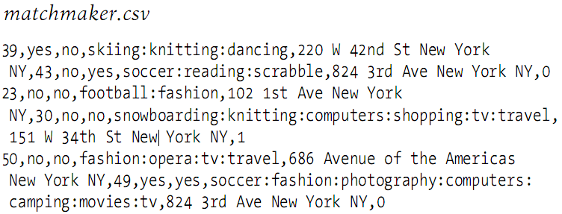
Matchmaker Dataset
Matchmaker dataset: basic information collected
  Age
  Smoker?
  Want children?
  List of interests
  Location
Data to download
  http://kiwitobes.com/matchmaker/agesonly.csv
  http://kiwitobes.com/matchmaker/matchmaker.csv
  Row data: information about a man and a woman, a 1 or 0 in final column to indicate a good match or not

Slide 4
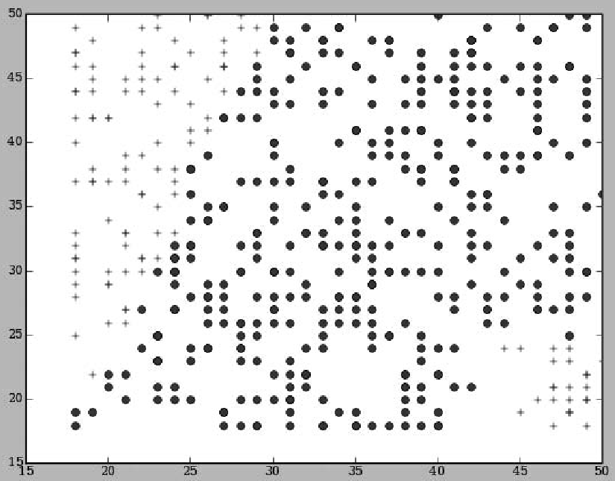
Scatter Plot: M’s age vs W’s age
Data can’t be linearly separate

Slide 5
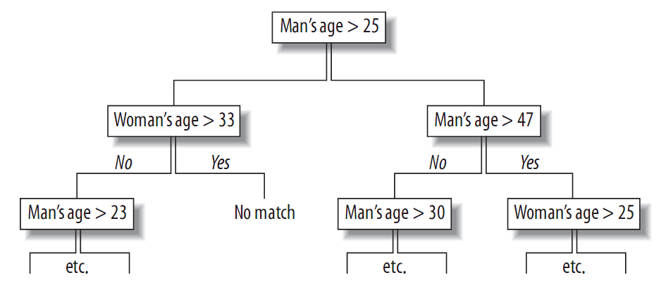
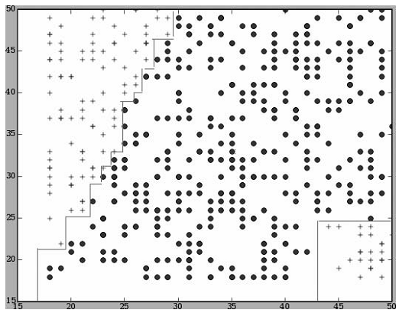
Use Decision Tree?
Still looks messy, useless for interpretation
decision boundary

Slide 6
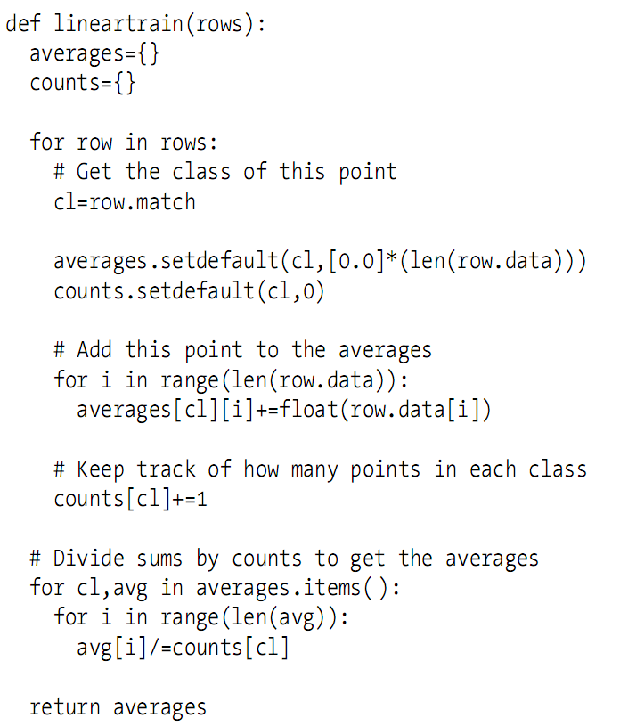
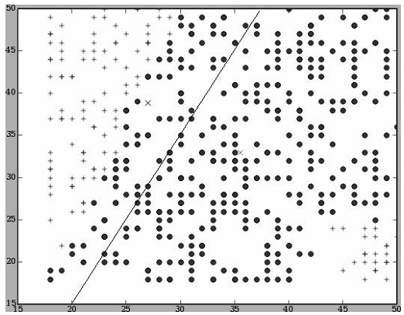
Basic Linear Classification
Calculate average point

Slide 7
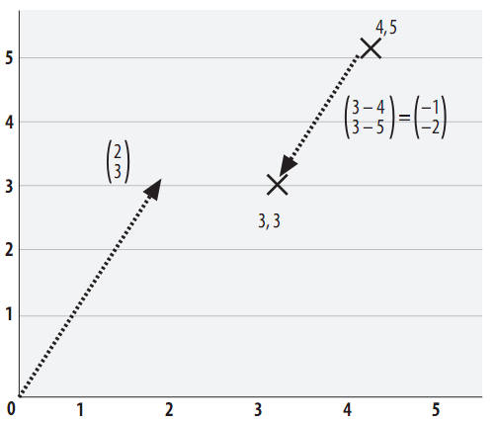

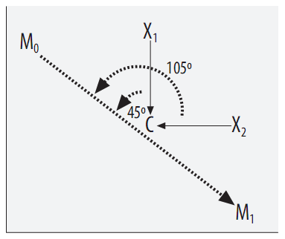
Vector and Dot-Product Distance

Slide 8
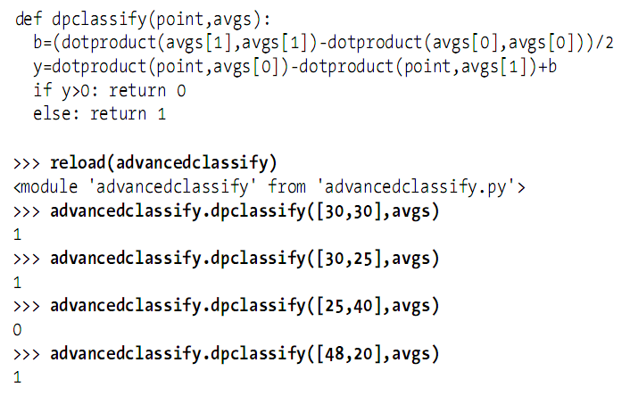
Dot-Product Classification

Slide 9
Other Notes
Categorical data transform
  Yes/No questions: 1 means yes, -1 means no, 0 means missing or ambiguous data
  Nominal data: convert to count
Data scaling

Slide 10
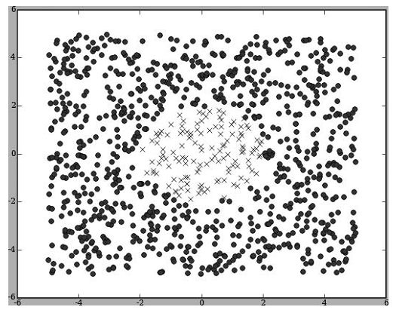
Kernel Methods
Data that can’t be linearly separated

Slide 11
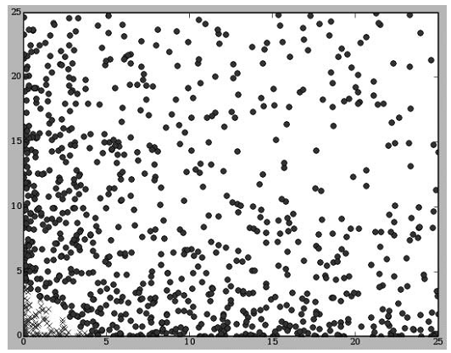
Data Transform May Help
What if we set x’= x², y’ = y² then draw (x’, y’)?
What if we set a=x², b=xy, c=y² ?
  More dimension will make it easier to find dividing line

Slide 12
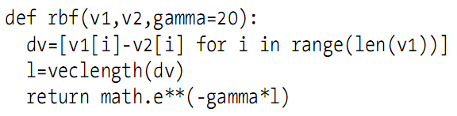
The Kernel Trick
Too many possible transformations
  But only a few are useful
RBF (Radial Basis Function): commonly used transformation

Slide 13
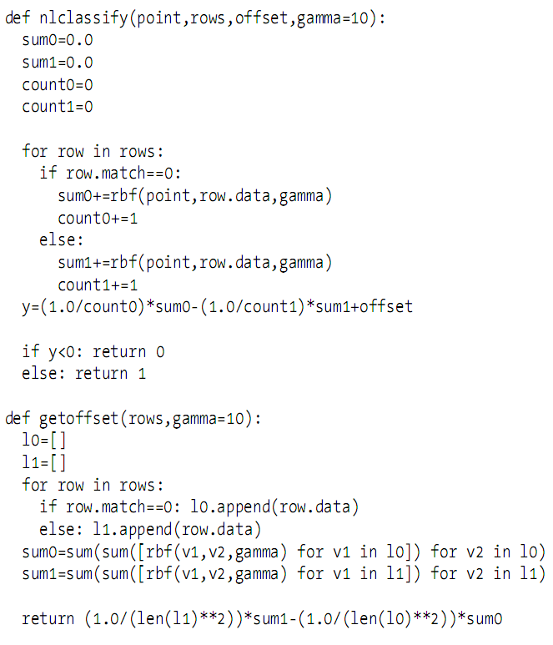
RBF Classification

Slide 14
Separating Hyperplane
The line used to separate the dataset
If we have a dataset with N dimension, we need a plane with N-1 dimension to separate it
  That’s why it called hyper(plane)!

Slide 15
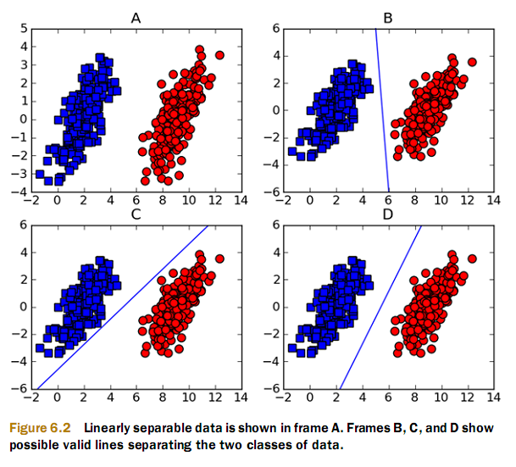
Linear Separable
So which one is better?

Slide 16
Margin
The distance between the hyperplane and the point closest to it
  These points are called support vectors
  Try to find the maximum margin as possible

Slide 17
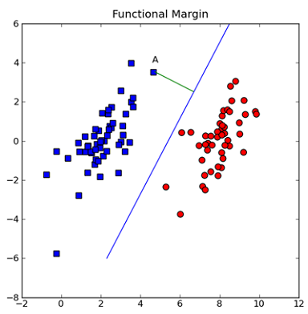


Point Distance
Separating hyperplane
Distance from point to hyperplane is measured by normal

Slide 18
Separation as Optimization
Use something like Heaviside step function but gives -1 and 1 rather than 0, 1
  f(u) = -1 if u<0, 1 otherwise
  Apply f(w^{T}x+b), so -1 and 1 represents each side of the hyperplane
Margin is calculated by label*(w^{T}x+b)
  Label is the class label, -1 or 1
Goal: find w and b
  Optimization problem!

Slide 19
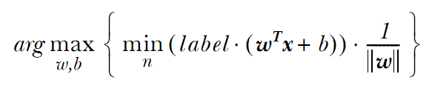
Separation as Optimization
Find the points with the smallest margin
  Support vectors
Then, maximize the margin

Slide 20
Using LibSVM
From: http://www.csie.ntu.edu.tw/~cjlin/libsvm
See readme for more instructions

Slide 21
Summary
SVM is a binary classification machine
Support vectors have good generalization error
Kernel methods (tricks) are helpful in non-linear separable problems
  Usually from lower-dimension to higher-dimension
RBF is a popular kernel that measures the distance between two vectors

